Slide 1

6 August 2022
AGILE IMPLEMENTATION

Slide 2
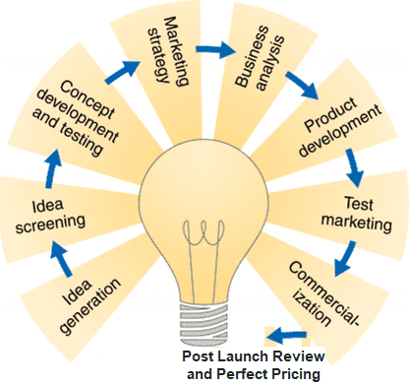
AGILE IMPLEMENTATION
Agile Implementation - Agenda
Agile
SAFe Overview
Workflow view
DevOPS view
Knowledge Management
Build vs Partner vs Buy
Test
Features
Rollout changes to users
Project
Charter
Develop
Features
Project
Plan
Idea Collaboration
Manage
Sprint
Discovery
Delivery
Design
Features
Close
release
Release
Initial
design
Initiate
Setup
foundation
Vision
Deploy
code
Close
Sprint
Sprint
Planning
Business
Idea
Establish
high level architecture

Slide 3
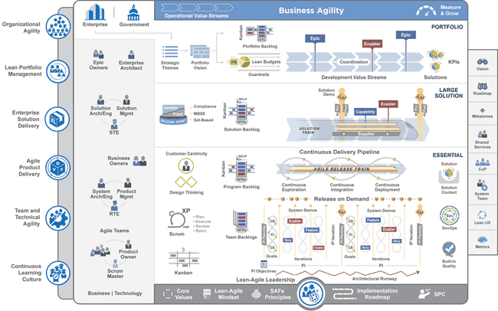
AGILE IMPLEMENTATION
SAFe Overview
SAFe Overview
Agile | Tasks
Kanban | Initiation - POC, Discovery - Research to EPIC, EPIC to Technical Solution, Retrospective Actions
Scrum | Delivery - Development and Testing
XP | Initiation - Ux / Cx, Discovery, Delivery - Ux / Cx, Estimation, Release - Deployment and Release Management

Slide 4
AGILE IMPLEMENTATION
Workflow View
Workflow View
Frequent intake of business need
Product/Portfolio
Manager
Define Epic Backlog
Define Product Roadmap
Approved?
Business
Plan, Define
Create Test Strategy
Elicit Business Requirements
Define Features and Releases
Define Product Backlog
Refine Sprint Backlog
Product
Owner
Sprint Planning
Sprint Backlog
Item
“User Story”
Refine Requirements
Define Acceptance Criteria
Design Solution
Partially Automated Code, Test, Build, Deployment
Scrum Master
Create Code
Test
Code
No
Yes
Yes
Development
Design, Build, Test
Works?
Sprint Done?
No
Dev
Team
Review Sprint
User Demonstration and Feedback
Retrospective (Refine Process)
Inform Change Management
Release
Manager
Deploy
Build Deployment Plan
Approved?
Deploy Prod. Version
Deployment Report
Operations
Accept Support Requests
Log Incident
Redirect to Resolver
Update Incident
Close Incident
Incidents, Issues, Problems
Operations
Maintain

Slide 5
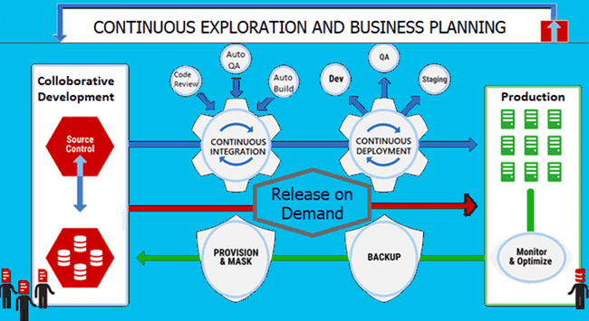

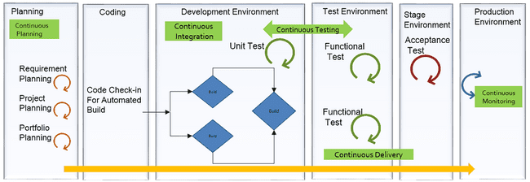
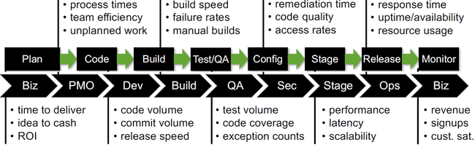
AGILE IMPLEMENTATION
DevOPS view
DevOPS view

Slide 6
AGILE IMPLEMENTATION
Knowledge Management
Reusability, Impact Analysis and Improvement Process
Reuse
Architecture
Source Code
Best Practices
Test Suite
GUI
Plans
Templates & Frameworks
Continuously Improve
Review Checklist
Root Cause and Preventative Actions
Process
Culture
Clean Policy
Peer Review
Customer Satisfaction
Impact Analysis
Architecture
Source Code
Documentation
Test Suite
GUI
Traceability
Database

Slide 7
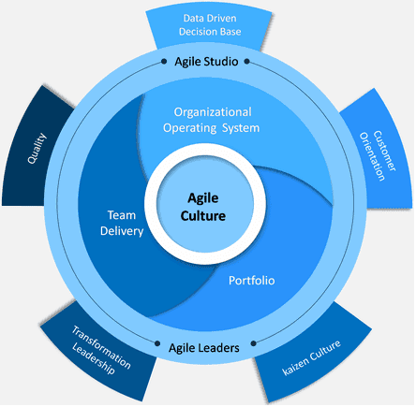
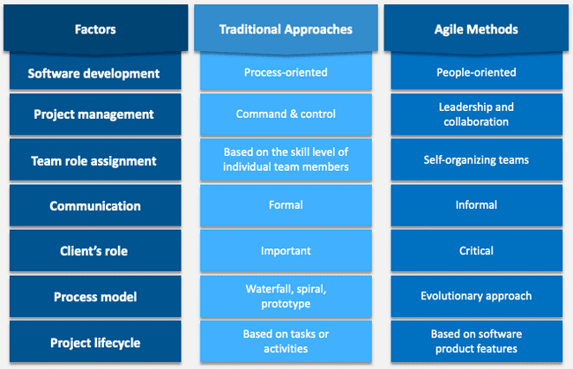
AGILE IMPLEMENTATION
Resource Shift Left Mindset
Resource Shift Left Mindset

Slide 8
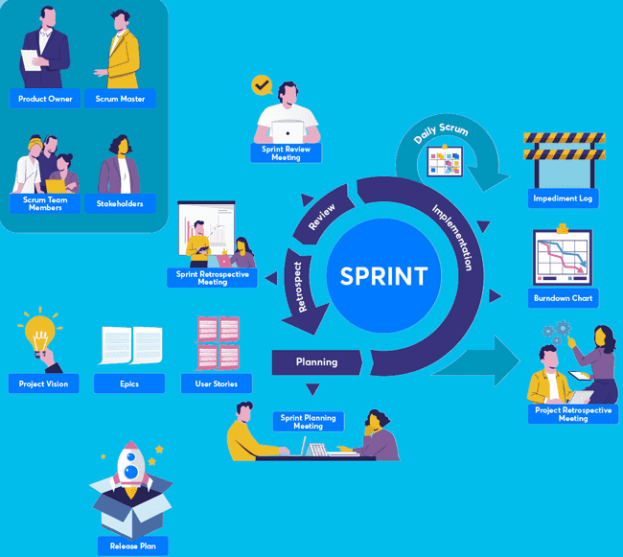
AGILE IMPLEMENTATION
Agile Meetings
Agile Meetings

Slide 9
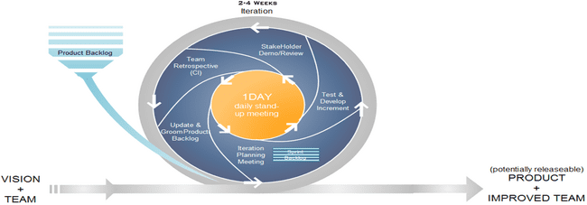
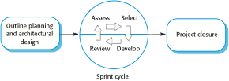
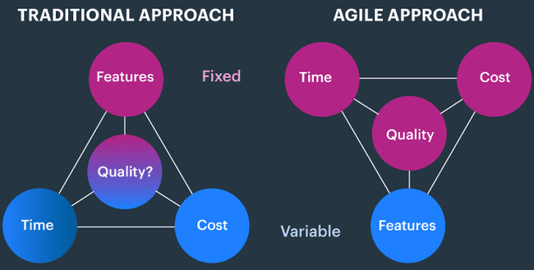
AGILE IMPLEMENTATION
Agile Iteration Details
Agile Iteration Details

Slide 10
AGILE IMPLEMENTATION
Agile Sprint Planning
Agile Sprint Planning
Sprint 0
Sprint 1
Sprint 2
Sprint 3
Iteration 1 functional specification ready
data gathering for iteration 2 functional specification user stories, acceptance criteria
design for iteration 1 features –technical specification
gather user input for iteration 3 features functional specification user stories, acceptance criteria
design iteration 2 features
support iteration 1 development and
testing
gather user input for iteration 4 features
design iteration 3 features
support iteration 2 development and testing
Automate iteration 1 features verifications
gather user input for iteration 5 features
design iteration 4 features
support iteration 3 development and testing
Automate iteration 2 features verifications
Product Owner Team
feature design
feature design
+ bugs found in
Integration or automation testing
support dev
coded features
support dev
implement iteration 3 features
fix iteration 2 bugs if any
Development and Testing Team
development environment setup
architectural “spikes”
implement iteration 1 features
implement iteration 2 features
fix iteration 1 bugs if any
time

Slide 11
AGILE IMPLEMENTATION
Agile Sprint Retrospective
Agile Sprint Retrospective
What works
What doesn't work
Stakeholder Feedback
Continuous Improvement
Action Plan

Slide 12
AGILE IMPLEMENTATION
Agile Maturity Model
Agile Maturity Model
Practice | Build management and continuous integration | Environments and deployment | Release management and compliance | Testing | Data management
Optimizing: Focus on process improvement: self-organized, adaptive planning, sustainable, continual improvement, and automation for perpetual integration and deployment | Teams regularly meet to discuss integration problems and resolve them with automation, faster feedback, and better visibility. | All environments managed effectively. Provisioning fully automated. Virtualization used if applicable. | Operations and delivery teams regularly collaborate to manage risks and reduce cycle time. | Production rollbacks rare. Defects found and fixed immediately. | Release to release feedback loop of database performance and deployment process.
Quantitatively managed: Process measured and controlled: Measuring code quality and other key indicators focusing on engineering maturity | Build metrics gathered, made visible, and acted on. Builds are not left broken. | Orchestrated deployments managed. Release and rollback processes tested. | Environment and application health monitored and proactively managed. Cycle time monitored. | Quality metrics and trends tracked. Nonfunctional requirements defined and measured. | Database upgrades and rollbacks tested with every deployment. Database performance monitored and optimized.
Consistent: Automated processes applied across whole application product lifecycle: Applying well-defined agile processes and consistently delivering each sprint | Automated build and test cycle every time a change is committed. Dependencies managed. Re-use of scripts and tools. | Fully automated, self-service push-button process for deploying software. Same process to deploy to every environment. | Change management and approvals processes defined and enforced. Regulatory and compliance conditions met. | Automated unit and acceptance tests, the latter written with testers. Testing part of development process. | Database changes performed automatically as part of deployment process.
Repeatable: Process documented and partly automated: Agile tools and practices become common place across all teams | Regular automated build and testing. Any build can be re-created from source control via auto process. | Automated deployment to some environments. Creation of new environments is cheap. All configuration are versioned. | Painful and infrequent, but reliable, releases. Limited traceability from requirements to release. | Automated tests written as part of story development. | Changes to databases done with automated scripts versioned with application.
Regressive: processes unrepeatable, poorly controlled, and reactive: Dev and QA are not yet fully in sync. | Manual processes for building software. No management of artifacts and reports. | Manual process for deploying software.Environment-specific binaries. Environments provisioned manually. | Infrequent and unreliable releases. | Manual testing after development. | Data migrations unversioned and performed manually.

Slide 13



AGILE IMPLEMENTATION
Build vs Partner vs Buy
Build vs Partner vs Buy
Maturity
ROLE
Struggle
Support
Optimize
Expand
Transform
Improve
Integrate
Buy
Time to Implement
Non Core Competencies
Risk Elimination
Build
Control and Customization
Core Competencies
Partner
Expertise and Speed
Maintenance and Support
Risk Sharing

Slide 14

Thank you!
S. Lakshmanaraj
Lakshmanaraj.Sankaralingam@ideastoimpacts.com
https://www.linkedin.com/in/lakshmanarajsankaralingam/
“Accelerating the future of work thereby,
Distributing the future evenly”
www.ideastoimpacts.com

